Slide 1
Chord Diagrams
Ryan Sun

Slide 2
What for?
Visualize weighted relationships between several entities
Data in a matrix
Compare relative magnitudes of “flow” between entities
Aesthetically pleasing visualizations
Common uses:
Migration studies
Economic flows
Genome studies
In d3, a circular layout
https://en.wikipedia.org/wiki/Chord_diagram

Slide 3
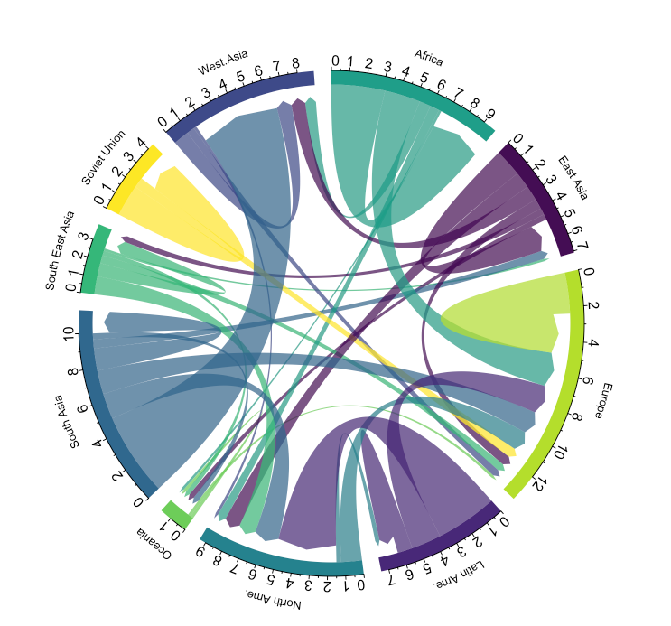
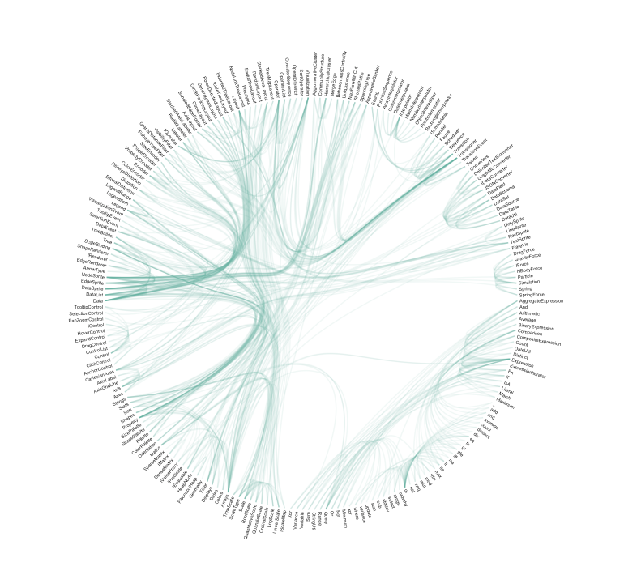
Representation
Flows/connections between several entities (groups)
Each group is represented by a fragment of the outer shell, an arc.
Chords are drawn between groups
Size of chord is proportional to the relative weight of the flow
Straight lines would quickly become unreadable given large amounts of data
Quadratic Bézier curves
“Hierarchical edge bundling”
Allows for adjacency relations, organized in a hierarchy
Decrease clutter
https://www.data-to-viz.com/graph/chord.html

Slide 4
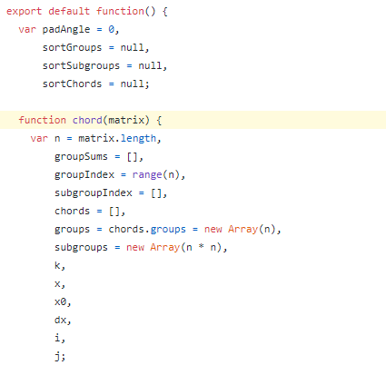
d3.chord() : Overview
Constructs a new chord layout with the default settings
Declaration: let chord = d3.chord()
Parameters
chord.padAngle(angle)
chord.sortGroups(comparator)
chord.sortSubgroups(comparator)
chord.sortChords(comparator)
chord.matrix(data) Deprecated in V5
Instead: const chords = chord(matrix)
Returns: Array of chords (objects)
https://github.com/d3/d3-chord

Slide 5
d3.chord() : Groups
[ [1,2,3,4,5],
[6,7,8,9,1],
[2,3,4,5,6],
[7,8,9,1,2],
[3,4,5,6,7] ]
Data is specified by setting the associated matrix
Group data is retrieved by using the groups accessor
const chords = chord(matrix)
const groups = chords.groups
The matrix must be a squared matrix
Each row corresponds to an entity (group)
The same index in each row corresponds to the same reference node for the flow
chord.sortGroups(comparator)
Sort the rows by sum
chord.sortSubgroups(comparator)
Sort elements by value
Group 1:
[1,2,3,4,5]
Subgroup of Group 1:
1,2,3,4,5
Flow into Group 1:
1,6,2,7,3
https://d3-wiki.readthedocs.io/zh_CN/master/Chord-Layout/#groups

Slide 6
d3.chord() : Chords
chord(matrix) returns an array of (N/2)(N+1) chords, where N = number of groups
Each chord represents the combined bidirectional flow between the source and target (source can equal target), where each object has properties:
index (source node index)
subindex ( target node index)
startAngle (starting angle in radians)
endAngle (ending angle in radians)
value (weight or matrix flow value)
Typically, this result is passed to d3.ribbon(), a path generator
To display the network relationships (draw the path)

Slide 7
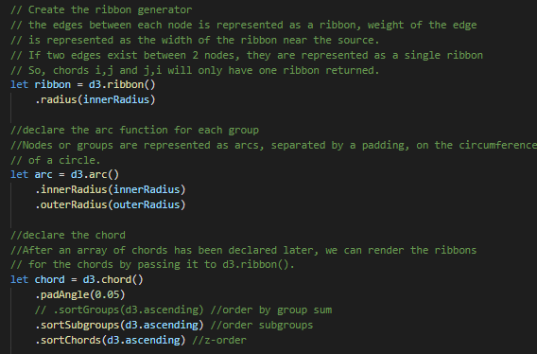

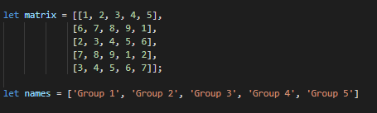



Tutorial - initialization

Slide 8
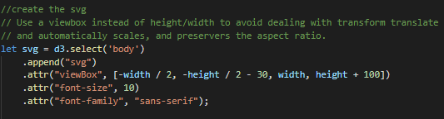
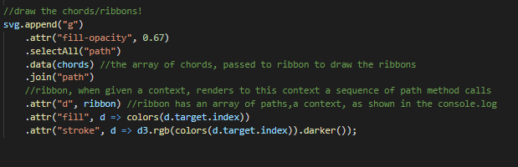
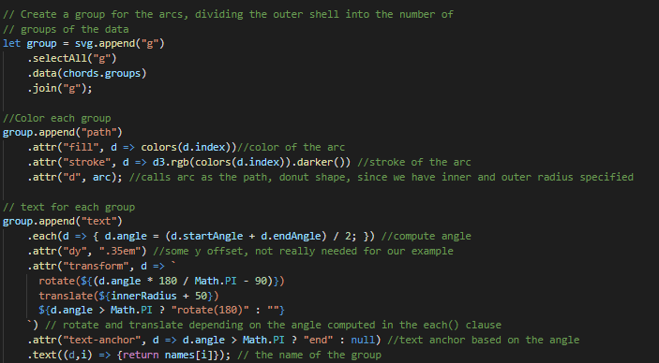
Tutorial - SVG

Slide 9
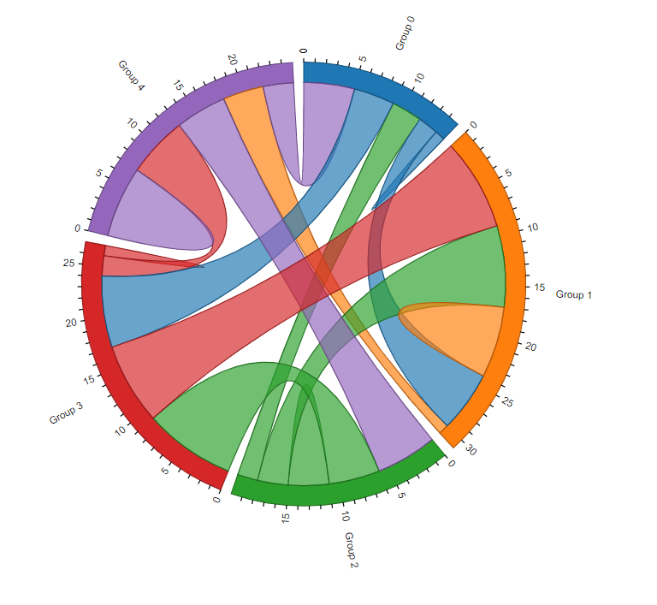
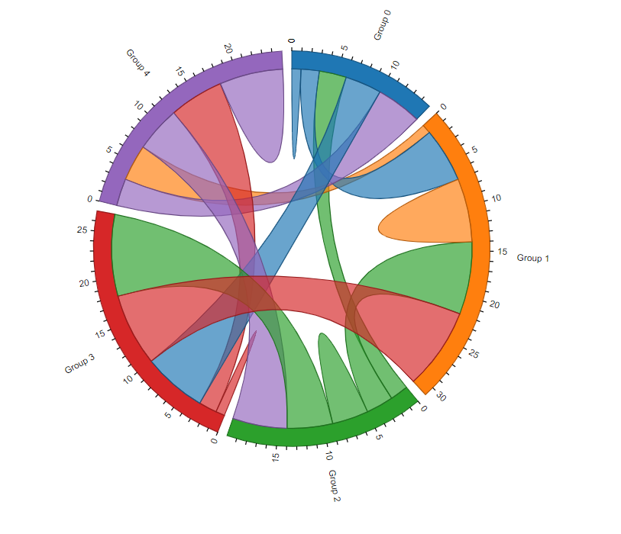
Results
Descending subgroups
Ascending subgroups

Slide 10
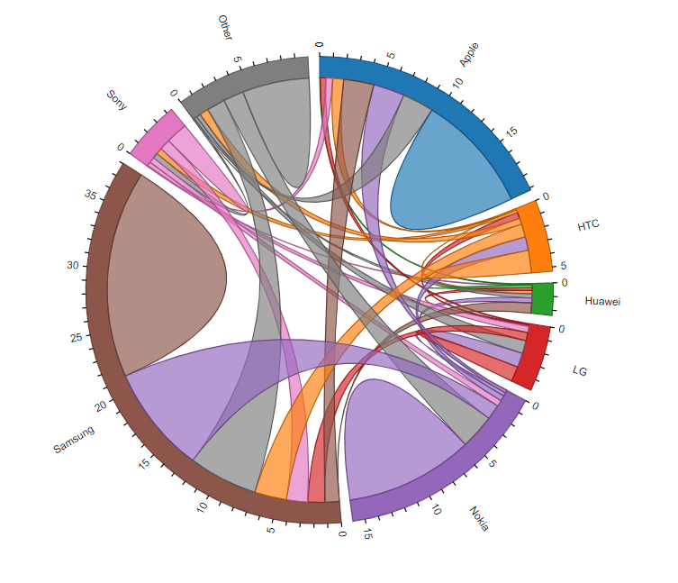
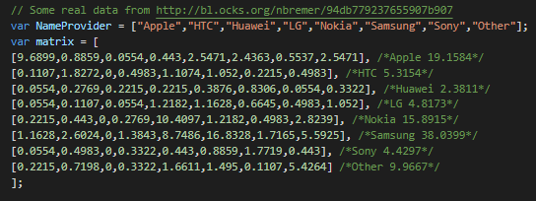
Results - with real data

Slide 11
Questions?

